Slide 1


Digit Recognition with Linear Algebra
Jon Loftin, PhD
jloftin@mathworks.com

Slide 2
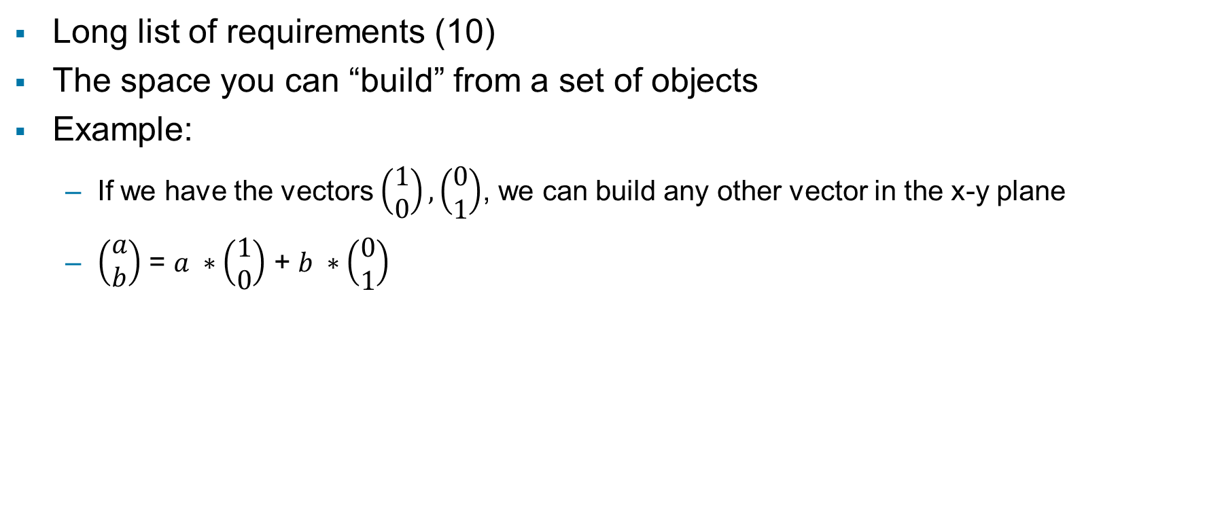
What is a vector space?
Long list of requirements (10)
The space you can “build” from a set of objects
Example:
  If we have the vectors $\left(\begin{aligned}1 \\ 0\end{aligned}\right),\left(\begin{aligned}0 \\ 1\end{aligned}\right)$, we can build any other vector in the x-y plane
  $\left(\begin{aligned}a \\ b\end{aligned}\right)$ = $a ∗\left(\begin{aligned}1 \\ 0\end{aligned}\right)$ + $b ∗\left(\begin{aligned}0 \\ 1\end{aligned}\right)$

Slide 3

Our vector space built by digits
Think of a digit as one of these building blocks
We can build a vector space for each digit, why?
Then, we see which digit space a test digit is “closest” to

Slide 4
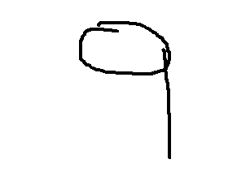



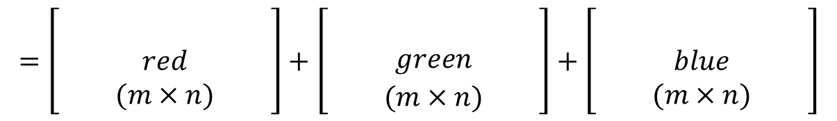

First things first… the images
grey-scale
Images can be represented as matrices
$n×n$ image
$$n$$
Numerical value based on RGB code
$$=\left[\begin{matrix} & & \\ & red & \\ & (m×n) & \end{matrix}\right]+\left[\begin{matrix} & & \\ & green & \\ & (m×n) & \end{matrix}\right]+\left[\begin{matrix} & & \\ & blue & \\ & (m×n) & \end{matrix}\right]$$
$$m$$

Slide 5



Example

Slide 6

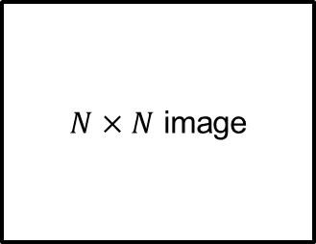

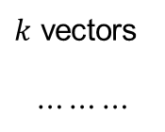
Setting up our recognition system
Suppose we have $k$ written images which have been classified as digit $i$. Use these to form our recognition system
$N×N$ image
$k$ vectors
$$⋯⋯⋯$$
$N^{2}×1$ vector
matrix $M$
Source: https://mathematics.ucsd.edu/sites/math.ucsd.edu/files/undergrad/honors-program/honors-theses/2017-2018/Zecheng_Kuang_Honors_Thesis.pdf

Slide 7
Setting up our recognition system
Matrix M
Calculate rank
Do Gram Schmidt on the columns
Column space = digit space
Repeat for all digits
Matrix M
Calculate SVD: M=UΣV
Get the column space of M from matrix U
Column space = digit space
Repeat for all digits

Slide 8
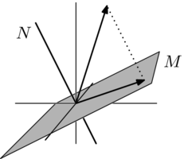



Let’s visualize this
Let $\overset{⃑}{q}$ represent the vector created by our test digit
M is our space for a particular digit
$$\overset{⃑}{q}$$
M

Slide 9
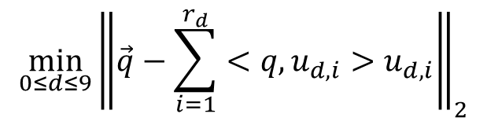
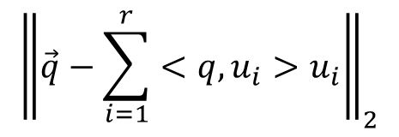

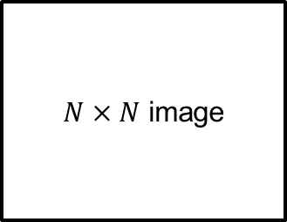
The final touch…projection to subspace
Suppose we are given an unknown image of a digit. Do the pre-processing as before and get a vector $\vec{q}$. We want to calculate the “digit space” that $\vec{q}$ is closest to.
$${\left\|\vec{q}−\sum_{i=1}^{r}{<q,u_{i}>u_{i}}\right\|}_{2}$$
$N×N$ image
$N^{2}×1$ vector
$$\min_{0≤d≤9}{{\left\|\vec{q}−\sum_{i=1}^{r_{d}}{<q,u_{d,i}>u_{d,i}}\right\|}_{2}}$$
Source: https://mathematics.ucsd.edu/sites/math.ucsd.edu/files/undergrad/honors-program/honors-theses/2017-2018/Zecheng_Kuang_Honors_Thesis.pdf

Slide 10

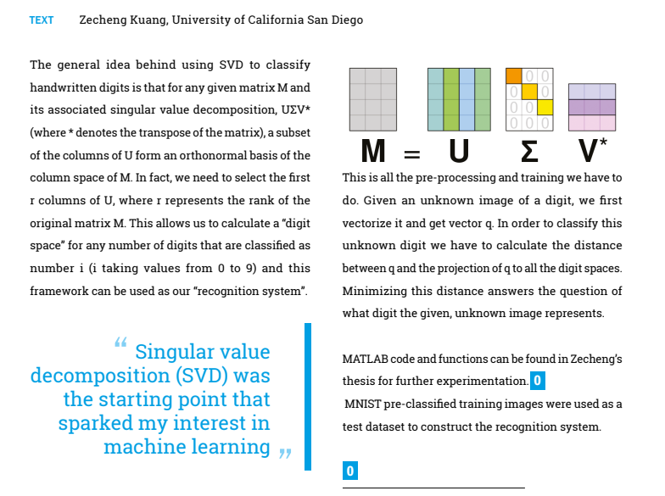


Short version of this work…
Source: https://supremum.gewis.nl/data/supremum_54.2_magazine.pdf

Slide 11
Thank you!

